Slide 1

Intro to React
Thinking in React
Terrence Mahnken - Software Developer

Slide 2
Agenda
What is React?
How does React work?
Why use React?
How do we use React?
Thinking in React

Slide 3



What is React?
Created by Facebook
First public release was in July 2013
JavaScript library for building UIs.
Built using reusable components.
Added to an existing website or built using several toolchain
Create React App (CRA): Learning React and/or creating single-page apps (SPAs)
Gatsby: Static content-oriented website
Next.js: Server-rendered website with Node.js
Many, many more
Takes its inspiration from from template systems. (ASP, Mustache, Velocity, etc.)

Slide 4
How does React work?
The Virtual DOM
In memory
Synced with the “real” DOM (known as “reconciliation”)
Abstracts traditional JS processes (attribute manipulation, event handling, manual DOM updating, etc.)
Individual components - lifecycle, state, handlers
Ultimately, it’s just JavaScript

Slide 5
The Component Tree

Slide 6
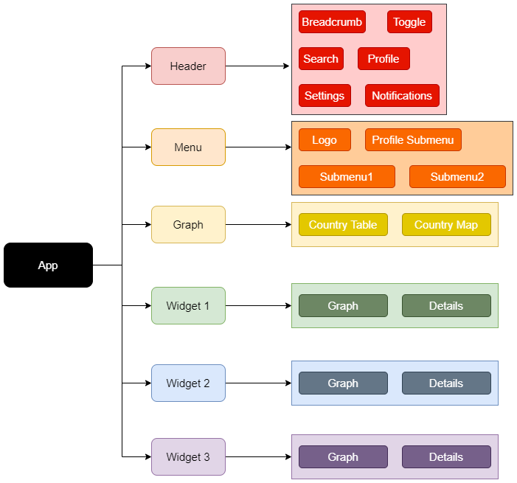
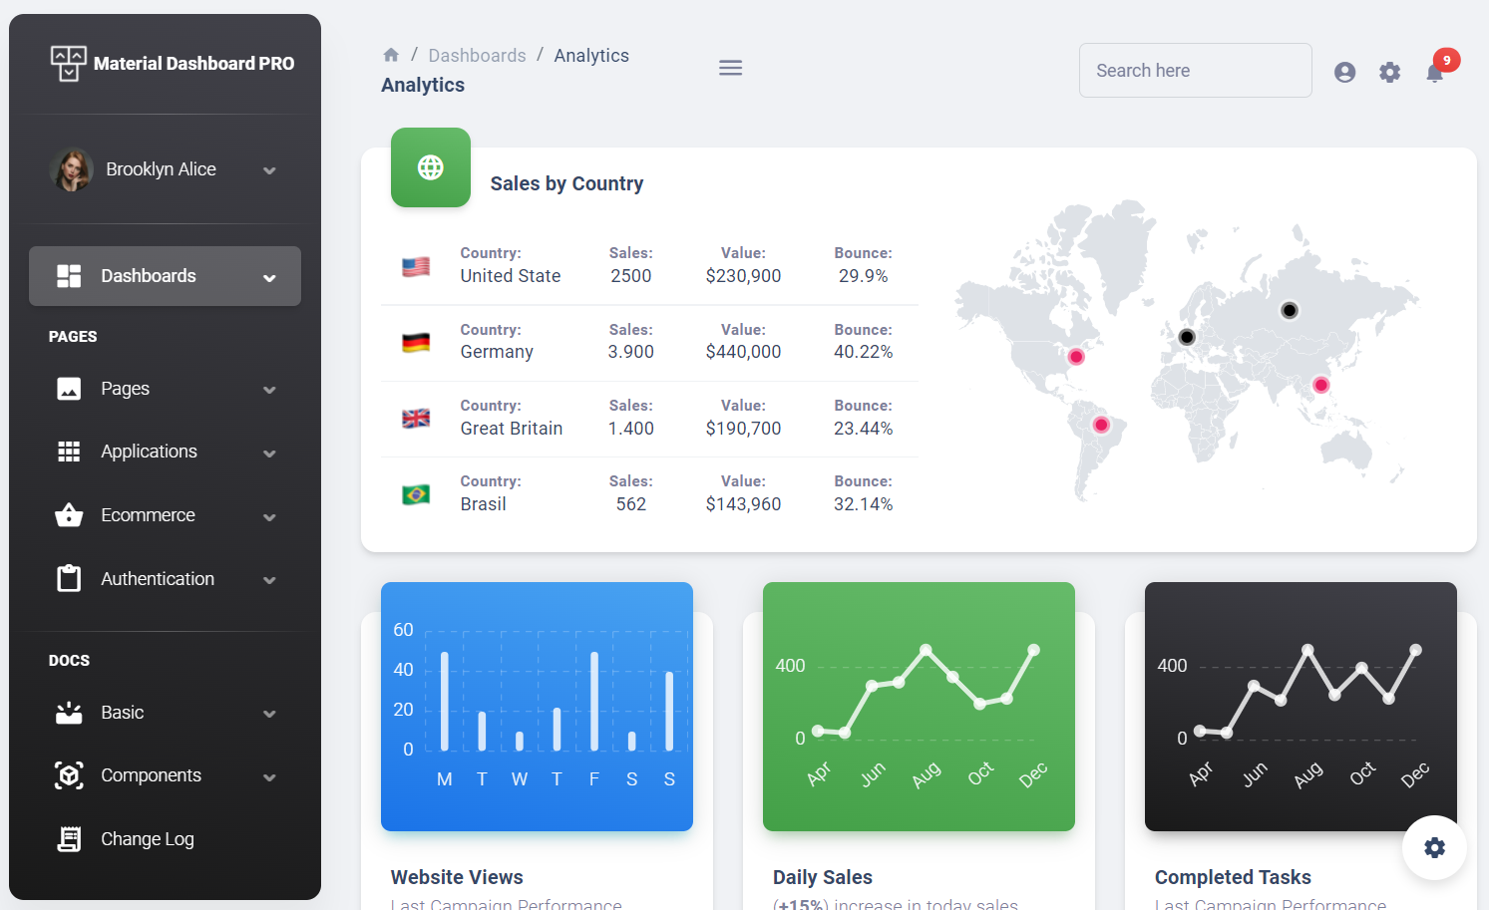
The Component Tree

Slide 7
Why use React?
Easy creating of dynamic applications
Improved performance
Reusable components
Unidirectional data flow*
Small learning curve* (HTML, CSS, and some JS)
Development of web and mobile applications
Dedicated debugging tools
Huge developer community and support system
Numerous libraries

Slide 8
How do we use React?
JSX (“JavaScript Syntax Extension” or “JavaScript XML”)
State & Properties (“props”)
Components: Class & Functional
Lifecycle Methods & Hooks
HTML & CSS in React
React Developer Tools

Slide 9
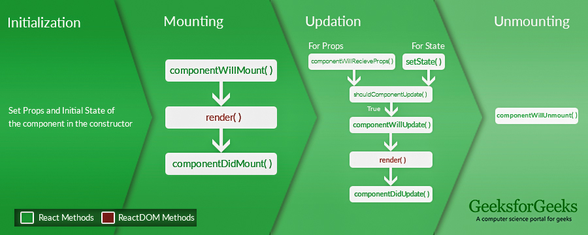
React: The Lifecycle of Components

Slide 10
Demo

Slide 11
Thinking in React
Design:
Break the UI into a component hierarchy.
Build a static version in React.
Identify the minimal (but complete) representation of UI state.
Identify where the state should live.
Add inverse data flow.
Technical:
Leverage the abstraction that React and React libraries provide.
Build, refactor, repeat.

Slide 12
Next React Session
Accessibility
Fragments
Refs and the DOM
Controlled vs Uncontrolled Components
Webpack & Babel
React 201

Slide 13
Sources
React Documentation
A short intro to React.js by Merdan Durdiyev (dev.to)
W3Schools - React Tutorial
The Missing Introduction to React by Eric Elliott (medium.com)
GeeksforGeeks - React JS (Introduction and Working)
React for Beginners - A React.js Handbook for Front End Developers by Flavio Copes (freecodecamp.org)
Why You Should Use React.js For Web Development by Suraj Surve (freecodecamp.org)
The Best Guide to Know What is React by Chinmayee Deshpande (simplilearn.com)
Understanding Functional Components vs. Class Components in React by Shiori Yamazaki (twilio.com)

